Slide 1


Keeping Customers on Board Predicting Netflix Customer Cancellations Using Data Sarah Theriot

Slide 2

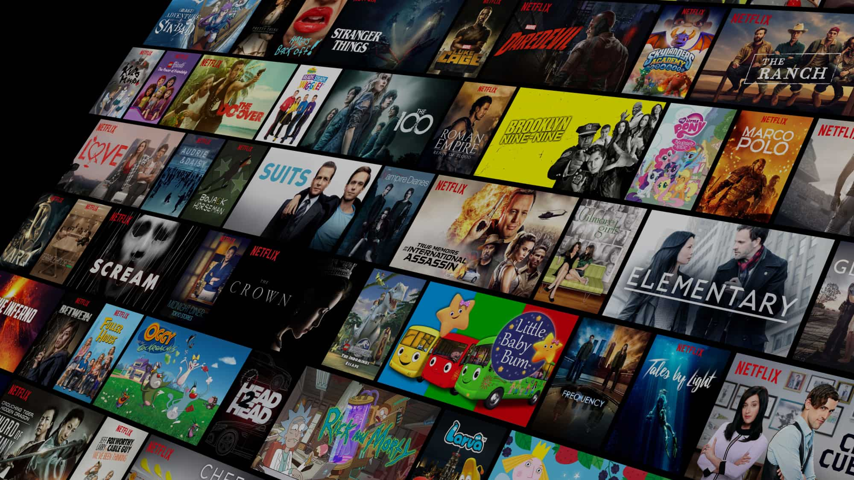
Why Predicting Churn Matters
Streaming services like Netflix rely on monthly subscribers to stay profitable
Losing customers (churn) can mean millions in lost revenue
Predicting churn helps companies take action before customers cancel
Data can reveal patterns in who is most likely to leave

Slide 3
Business Problems and Goals
Business Problem:
Netflix wants to lower customer churn by understanding which users are at risk of canceling.
Project Goals:
Build a model to predict which customers might churn
Find the most important factors linked to cancellations
Give clear insights to help Netflix keep more users

Slide 4
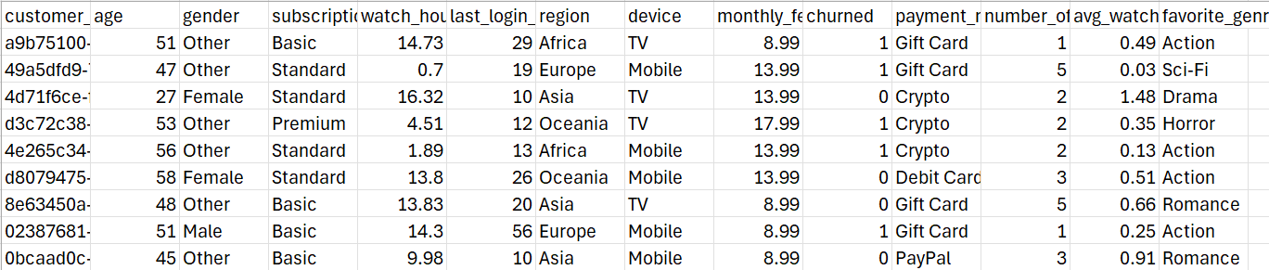
The Dataset
Synthetic dataset made to look like real Netflix data
5,000 customer records
Includes info like age, gender, watch habits, payment method, and whether they canceled
Useful for testing churn prediction models when real company data isn’t available

Slide 5
How I analyzed the data
Used Python in Jupyter Notebook
Cleaned and explored the data first
Created charts to find patterns in churn
Built a logistic regression model to predict who might cancel
Focused on clear results that Netflix could actually use

Slide 6
What the Model found
Model Accuracy: 87.7%
Top features that predict churn:
Less daily watch time
Fewer watch hours overall
Fewer profiles on an account
Higher monthly fee
Subscription type
These gave the biggest clues about who’s likely to leave.

Slide 7
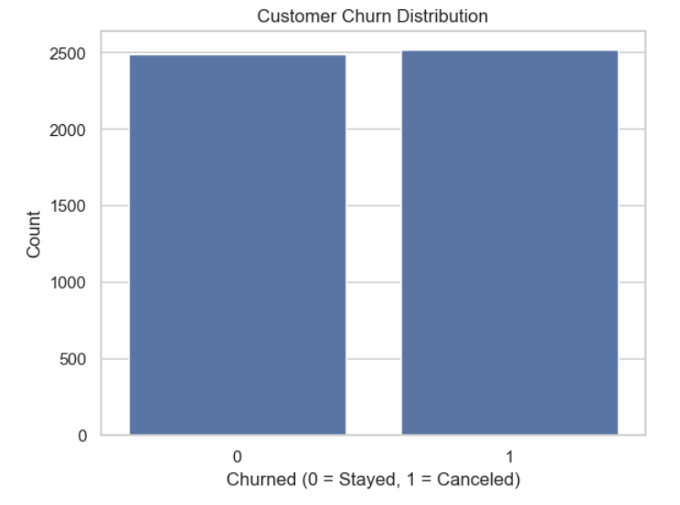
Who’s likely to churn?
About half of the customers canceled their subscription
Understanding this balance helps Netflix focus on the churn problem
Sets the stage for deeper analysis on why people leave

Slide 8
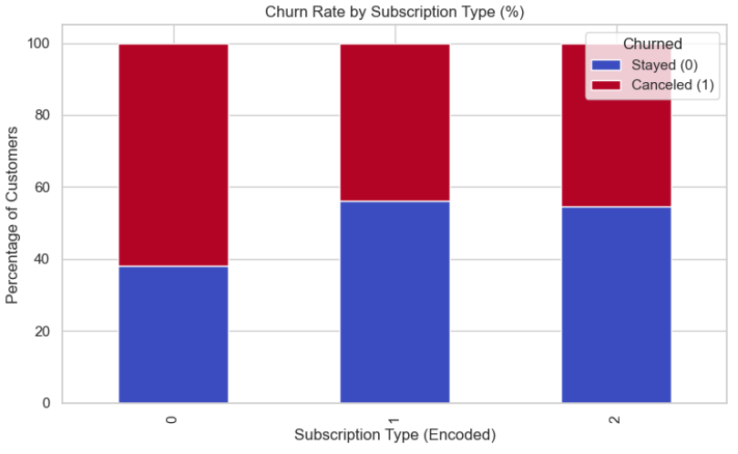
Subscription Type and Churn
Customers with basic plans cancel more often than those with premium plans
Subscription type is a strong signal of customer loyalty
Helps Netflix identify which plans need more attention for retention

Slide 9
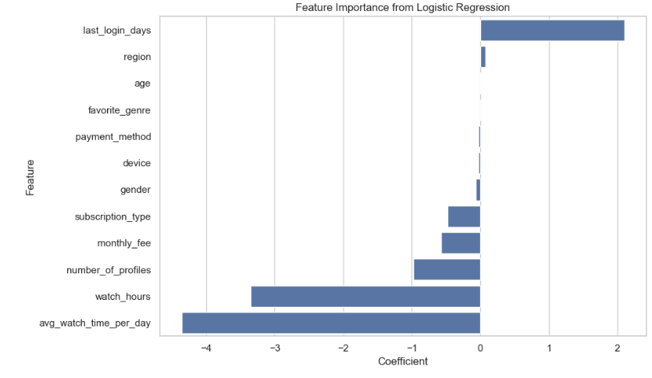
Feature Importance from Logistic Regression
Shows which factors most affect whether a customer cancels
Positive values increase chance of churn; negative values decrease it
Top influencers:
Days since last login (higher means more likely to leave)
Lower watch hours and average daily watch time
Fewer profiles on the account
Higher monthly fees

Slide 10
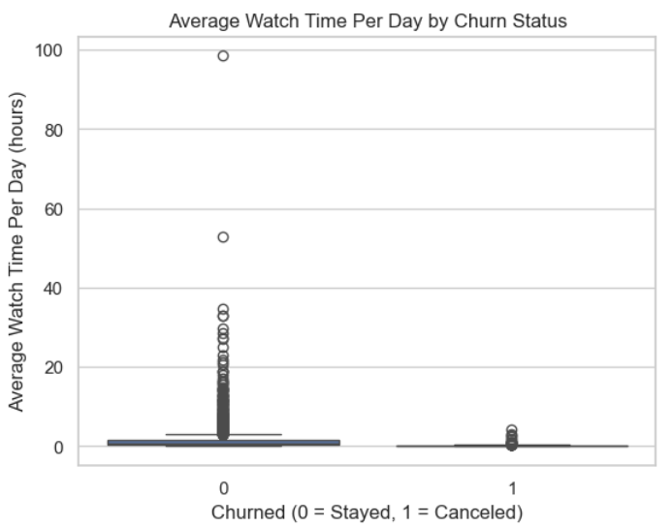
Do watching habits matter?
Customers who didn’t churn watched more each day on average
Lower daily watch time is linked to higher churn risk
Less engagement could be an early warning sign
Encouraging viewing might help reduce cancellations

Slide 11
Assumptions and Limitations
Synthetic data: This isn’t real Netflix customer data, so the patterns may not reflect actual behavior
Binary outcome: Customers are either marked as churned or not — but real-world churn is more complex
Feature limitations: We don’t know what content users watched, how long they’ve been subscribers, or any marketing data
Timeframe unknown: The dataset doesn’t include dates, so trends over time couldn’t be explored
This project is a strong starting point, but real business use would need deeper, real-time data

Slide 12
Business Recommendations
Based on what the model and visuals showed, here’s what Netflix could try:
Reach out early to users who haven’t logged in recently because they’re much more likely to churn
Adjust pricing or offer discounts for users with basic plans and lower watch time
Explore why people with more profiles churn because maybe shared accounts feel less personal?
Keep users engaged by recommending content tied to their favorite genre
Track changes over time to see if these actions actually reduce churn

Slide 13
Ethics and Privacy
Respecting customer privacy is key - data used to predict behavior should be secure and anonymous
Avoid targeting unfairly - don’t make biased decisions based on gender, age, or region alone
Explainability matters - people should understand why they're being flagged as likely to cancel
Be careful not to cross the line from helpful to invasive
Always put the customer experience first when using predictive models

Slide 14
Summary and Next steps
We used customer data to predict who might cancel their Netflix subscription
A logistic regression model helped identify key patterns such as watch time, login activity, and plan type
Visuals showed clear trends that can help Netflix target support and engagement
Next steps:
Try other models to compare accuracy
Test recommendations in real settings
Keep improving data collection and user feedback tracking

Slide 15
Questions?
Pre-Submitted Questions: 1. How accurate is your churn prediction model?
2. What features were most important in predicting churn?
3. Why did you choose logistic regression over other models?
4. How does the synthetic nature of the data affect your results?
5. Could the model be biased against certain groups?
6. How would Netflix use these predictions in practice?
7. Are there any risks in using customer data for churn prediction?
8. What additional data would improve your model?
9. How often should the model be updated?
10. What are the limitations of your analysis?

Slide 16
Questions Part 1:
1. How accurate is the model? The logistic regression model has about 88% accuracy, meaning it predicts churn pretty well most of the time.
2. Which features matter most for predicting churn? Days since last login, watch hours, number of profiles, and monthly fee are the biggest factors.
3. Is the data real? No, it’s synthetic, which means it’s made-up but designed to behave like real customer data.
4. How can Netflix use this model in real life? They can flag customers at risk and offer them special deals or reminders to keep them subscribed.

Slide 17
Questions Part 2:
5. Did you try other models besides logistic regression? Not for this milestone, but I chose logistic regression because it’s easy to interpret and great for binary outcomes like churn vs. no churn.
6. What does “churn” actually mean in this dataset? Churn just means a customer stopped using the service, they canceled or didn’t renew.
7. Were there any surprising patterns in the data? Yeah, people on family plans were less likely to churn than expected. Also, long-time users weren’t always the most loyal.

Slide 18
Questions Part 3:
8. Could any of the features be biased or misleading? Possibly. For example, “number of profiles” might be linked to account sharing, not customer satisfaction.
9. How could Netflix use this analysis in real life? They could flag accounts at high risk of churn and offer them tailored discounts, better content suggestions, or reminders to re-engage.
10. What would you do next if you had more time? I’d try other models like decision trees or random forests, and maybe add more features like customer support interactions or app usage logs.

Slide 19
Thank you for your time Sarah Theriot

